Slide 1
Propositional Logic, Part 3 Lecture 15 Chapter 7, Sections 7.4 and 7.5
Jim Rehg
College of Computing
Georgia Tech
February 17, 2016

Slide 2
Another Example: Autonomous Car

Slide 3
Model Checking

Slide 4
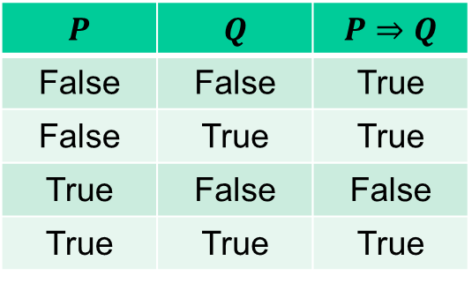
Inference Rules in Propositional Logic
$$P$$ | $$Q$$ | $$P⇒Q$$
False | False | True
False | True | True
True | False | False
True | True | True

Slide 5
Inference Rules in Propositional Logic
$$P$$ | $$Q$$ | $$P⇒Q$$
False | False | True
False | True | True
True | False | False
True | True | True

Slide 6


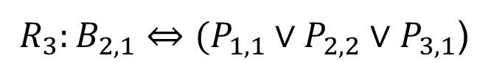
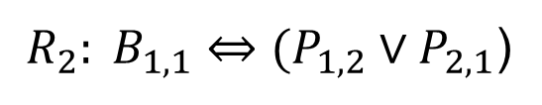

Proof by Logical Inference
$${R_{1}:¬P}_{1,1}$$
$$R_{4}:{¬B}_{1,1}$$
$${R_{5}:B}_{2,1}$$
${{ R}_{2}: B}_{1,1}⇔(P_{1,2}∨P_{2,1}$)
${{ R}_{3}:B}_{2,1}⇔(P_{1,1}∨P_{2,2}∨P_{3,1}$)

Slide 7
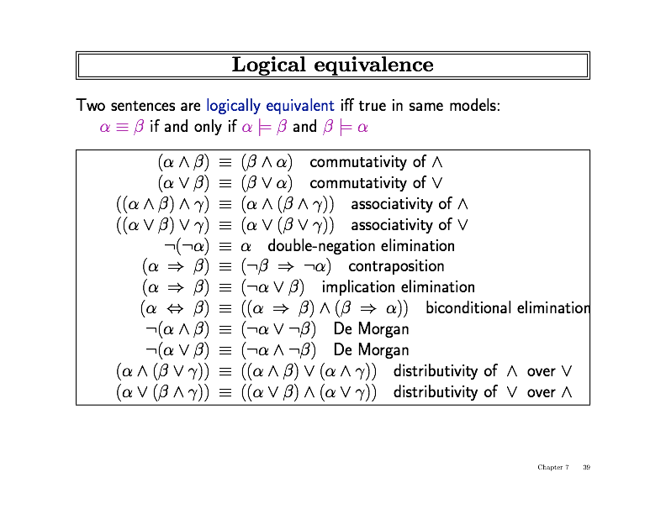
Logical Equivalence

Slide 8
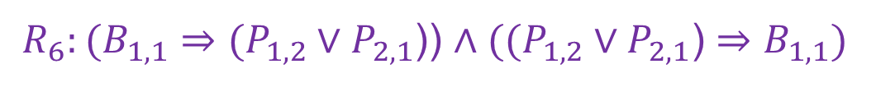


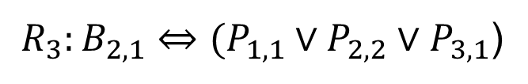
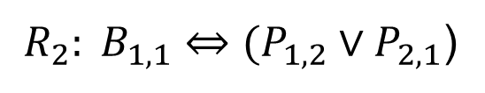

Proof by Logical Inference
$${R_{1}:¬P}_{1,1}$$
$$R_{4}:{¬B}_{1,1}$$
$${R_{5}:B}_{2,1}$$
${{ R}_{2}: B}_{1,1}⇔(P_{1,2}∨P_{2,1}$)
Biconditional
Elimination
${{ R}_{3}:B}_{2,1}⇔(P_{1,1}∨P_{2,2}∨P_{3,1}$)
${{ R}_{6}:(B}_{1,1}⇒(P_{1,2}∨P_{2,1}$)) $∧((P_{1,2}∨P_{2,1}\text{)}⇒B_{1,1})$

Slide 9

Proof by Logical Inference
$${R_{1}:¬P}_{1,1}$$
$$R_{4}:{¬B}_{1,1}$$
$${R_{5}:B}_{2,1}$$
${{ R}_{2}: B}_{1,1}⇔(P_{1,2}∨P_{2,1}$)
${{ R}_{3}:B}_{2,1}⇔(P_{1,1}∨P_{2,2}∨P_{3,1}$)
And
Elimination
${{ R}_{6}:(B}_{1,1}⇒(P_{1,2}∨P_{2,1}$)) $∧((P_{1,2}∨P_{2,1}\text{)}⇒B_{1,1})$
$$R_{7}: ((P_{1,2}∨P_{2,1}\text{)}⇒B_{1,1})$$

Slide 10

Proof by Logical Inference
$${R_{1}:¬P}_{1,1}$$
$$R_{4}:{¬B}_{1,1}$$
$${R_{5}:B}_{2,1}$$
${{ R}_{2}: B}_{1,1}⇔(P_{1,2}∨P_{2,1}$)
${{ R}_{3}:B}_{2,1}⇔(P_{1,1}∨P_{2,2}∨P_{3,1}$)
${{ R}_{6}:(B}_{1,1}⇒(P_{1,2}∨P_{2,1}$)) $∧((P_{1,2}∨P_{2,1}\text{)}⇒B_{1,1})$
$$R_{7}: ((P_{1,2}∨P_{2,1}\text{)}⇒B_{1,1})$$
Modus
Tollens
$$R_{9}: ¬(P_{1,2}∨P_{2,1}\text{)}$$

Slide 11


Proof by Logical Inference
$${R_{1}:¬P}_{1,1}$$
$$R_{4}:{¬B}_{1,1}$$
$${R_{5}:B}_{2,1}$$
${{ R}_{2}: B}_{1,1}⇔(P_{1,2}∨P_{2,1}$)
${{ R}_{3}:B}_{2,1}⇔(P_{1,1}∨P_{2,2}∨P_{3,1}$)
${{ R}_{6}:(B}_{1,1}⇒(P_{1,2}∨P_{2,1}$)) $∧((P_{1,2}∨P_{2,1}\text{)}⇒B_{1,1})$
$$R_{7}: ((P_{1,2}∨P_{2,1}\text{)}⇒B_{1,1})$$
$$R_{9}: ¬(P_{1,2}∨P_{2,1}\text{)}$$
De Morgan
We have inferred ${¬P}_{1,2}$ and ${¬P}_{2,1}$
$$R_{10}: {¬P}_{1,2}∧{¬P}_{2,1}$$

Slide 12
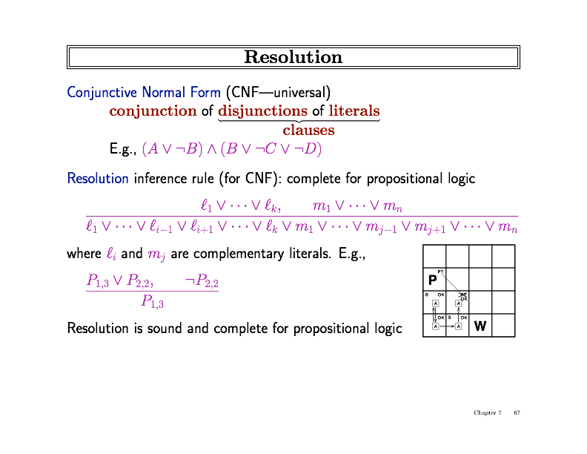
Proof by Resolution

Slide 13
Proof by Resolution

Slide 14
Proof by Resolution

Slide 15
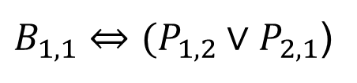
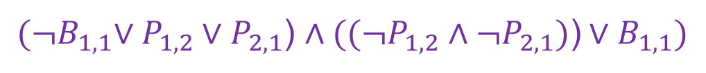
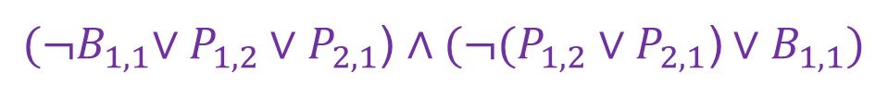
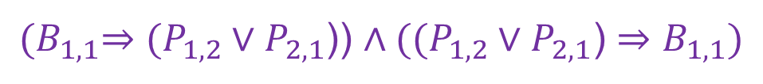
CNF Conversion
$B_{1,1}⇔(P_{1,2}∨P_{2,1}$)
${(B}_{1,1}⇒(P_{1,2}∨P_{2,1}$)) $∧((P_{1,2}∨P_{2,1}\text{)}⇒B_{1,1})$
${(¬B}_{1,1}∨P_{1,2}∨P_{2,1}$) $∧(¬(P_{1,2}∨P_{2,1}\text{)}∨B_{1,1})$
${(¬B}_{1,1}∨P_{1,2}∨P_{2,1}$) $∧((¬P_{1,2}∧{¬P}_{2,1})\text{)}∨B_{1,1})$
${(¬B}_{1,1}∨P_{1,2}∨P_{2,1}$) $∧(¬P_{1,2}∨B_{1,1})∧{(¬P}_{2,1}∨B_{1,1})$

Slide 16
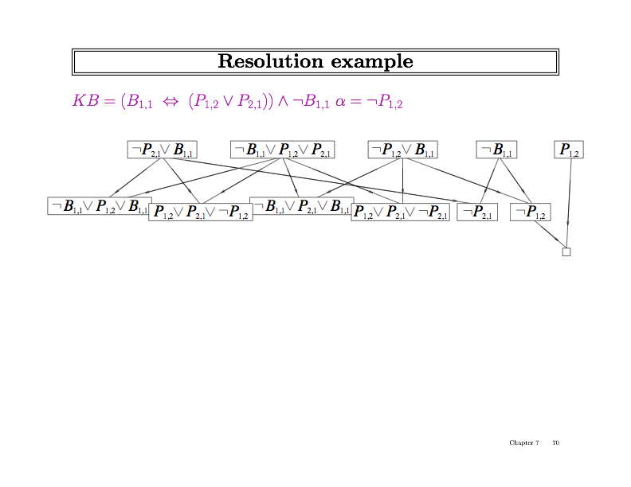
Resolution Example

Slide 17
Resolution Example

Slide 18
Resolution Example

Slide 19
Resolution Example

Slide 20
Resolution Example

Slide 21
Resolution Example
Contradiction, therefore our sentence is entailed.

Slide 22
Questions?

